Slide 1
Creating an email account (Gmail)
Thanks to wikihow.com

Slide 2
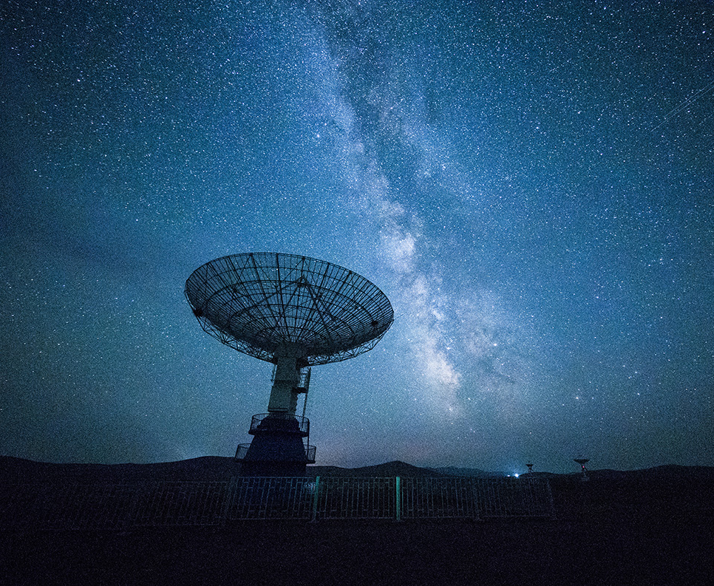
Start with going to this link!

Slide 3
To start creating, click on this link:

Slide 4
Network Technology
Fill out these boxes
Use a memorable username
Use a memorable password
A good password requires 3 of the 4 of the following:
Capital letter
Lower case letter
Number
Symbol

Slide 5
Congratulations!
You have created an email account!
Having an email account is necessary for creating other accounts such as:
Facebook
Twitter
YouTube
Duolingo
Just a few things:
Remember your password!
Create steps for recovery of your email in case you loose your password

