Slide 1
How to join a Zoom meeting
Before we start!

Slide 2
If you do not have a Zoom application…
www.zoom.us/download
Click to download the Zoom application
Follow the installation instructions

Slide 3
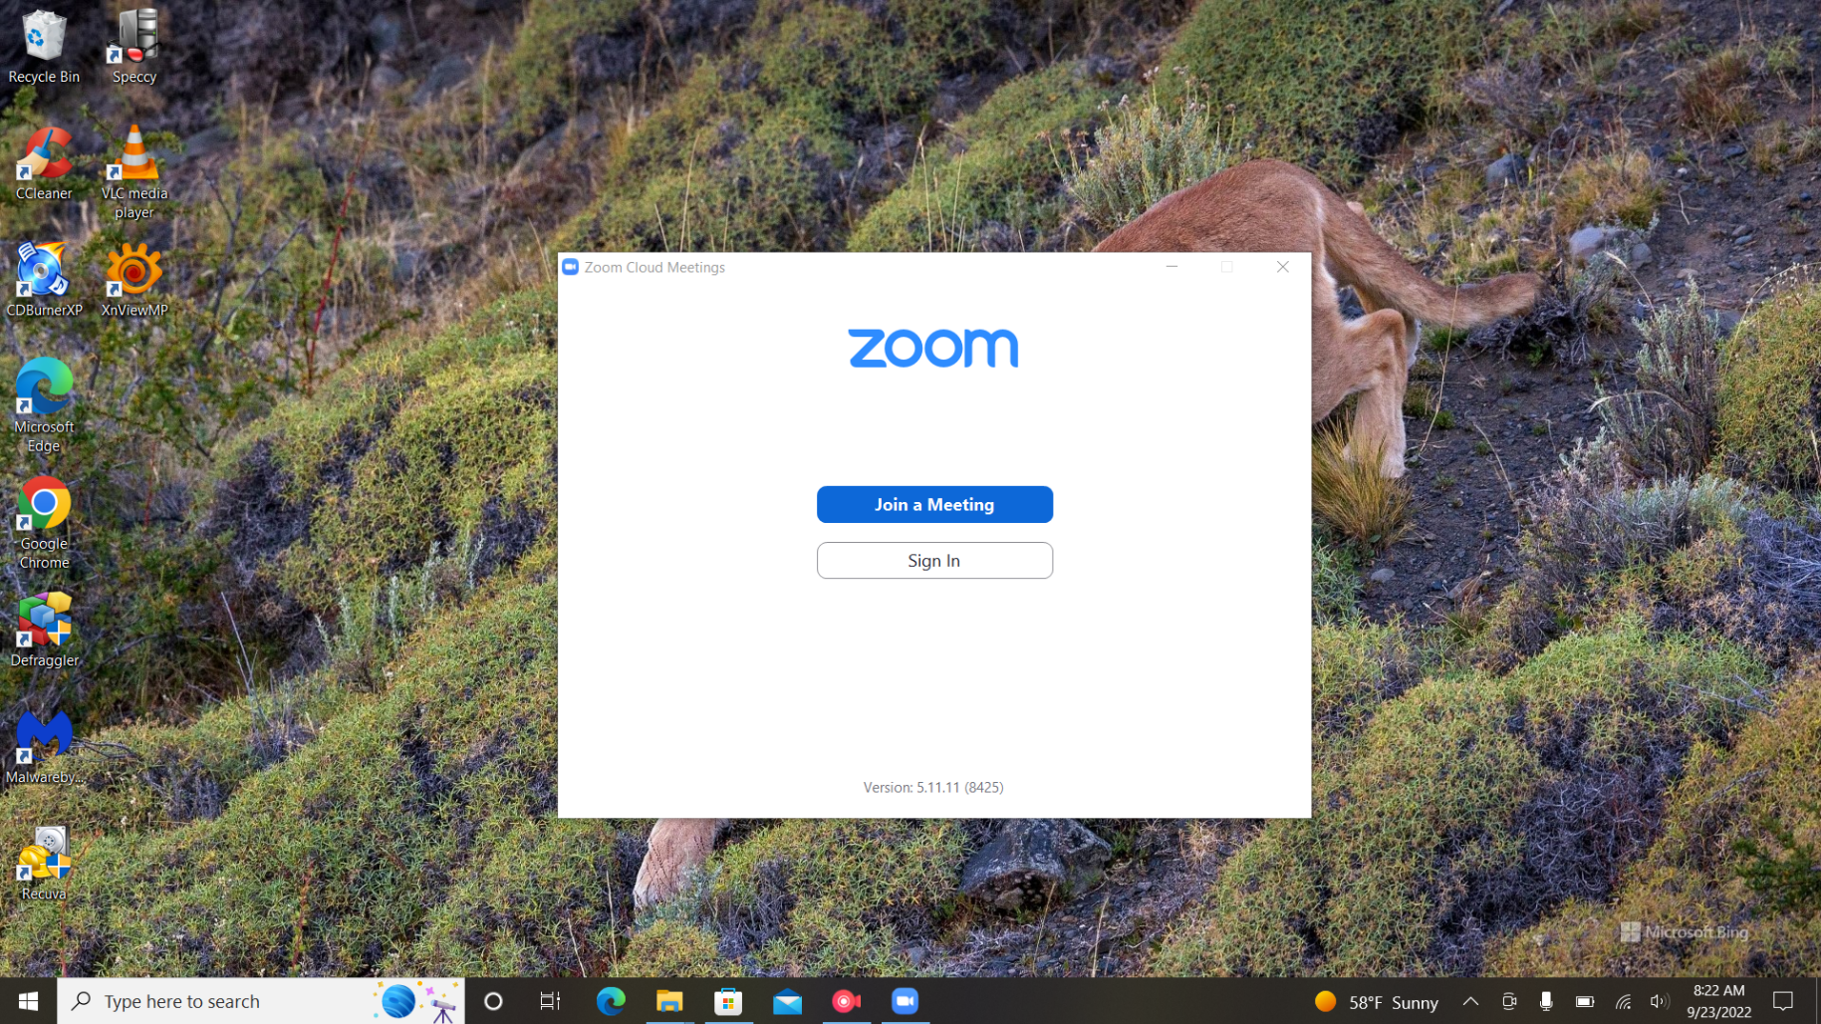
Step 1
Once you launch Zoom, you have a couple of options…
Join a Meeting as is
Sign in to a Zoom

Slide 4
Step 2
There are many options on this step
You can type in a meeting ID or use the ID of a Zoom user
You can join in with no microphone
You can join in with no video

Slide 5
Step 3
You’re in after filling out step 2!
There may be a waiting period for the person you are trying to connect.

Slide 6
Right before the meeting starts…
You will get this preview of what your camera sees
You can join without audio
You can join without video

Slide 7
You are in!

Slide 8
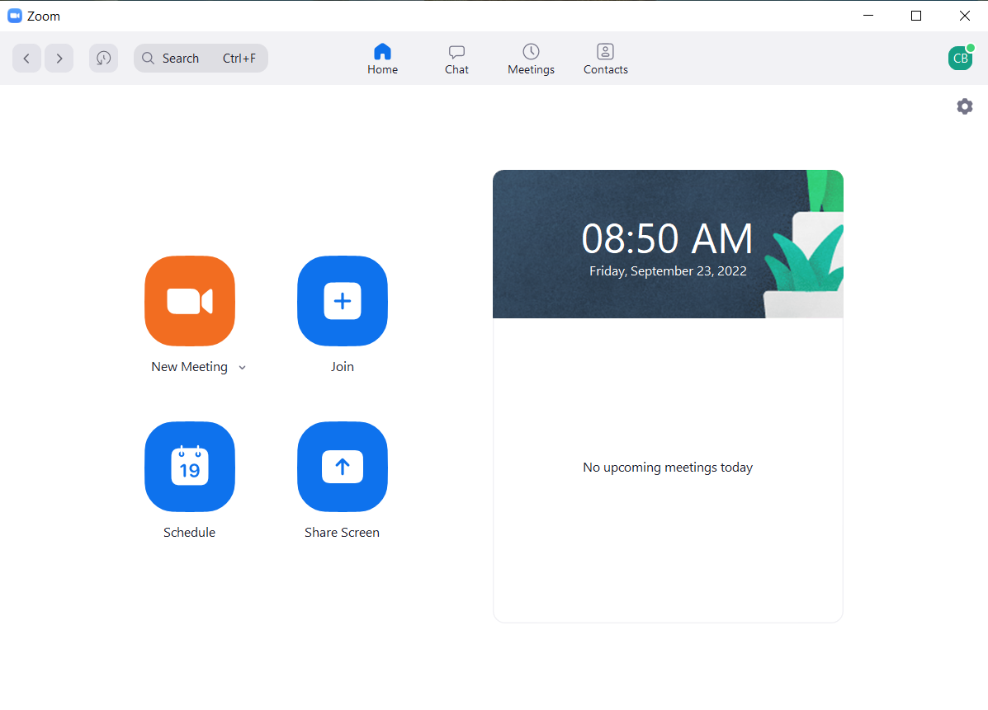
If you decided to create your own Zoom account and have signed in:
You are given a home page
You can:
Create a meeting
Join a meeting
Schedule future meetings
You can also share screens to other zoom members

